Slide 1


GROUP DISCUSSION 01
Sitanshu Mathukia
Sai Pavan Malisetty
Harpreet Singh
Rafael Cordero
Cole Hollingsworth
Yuanjun Jin
Xinwei Tang

Slide 2
TABLE OF CONTENT
IT-516 DATA STRUCTURES & ALGORITHMS
INSERTION
QUICK 3-WAY
MINPQ SORT
CONCLUSION AND SCREENSHOTS

Slide 3
insertion

Slide 4
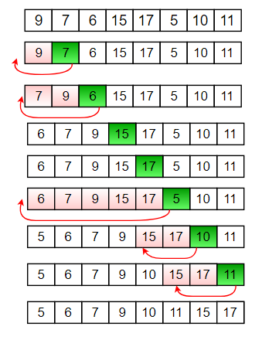
Insertion
Example
01
Insertion sort is a simple sorting algorithm that allows for efficient, in-place sorting of the array, one element at a time.
02
Basically, Insertion sort is efficient for small data values
03
Insertion sort is adaptive in nature, i.e. it is appropriate for data sets which are already partially sorted.

Slide 5
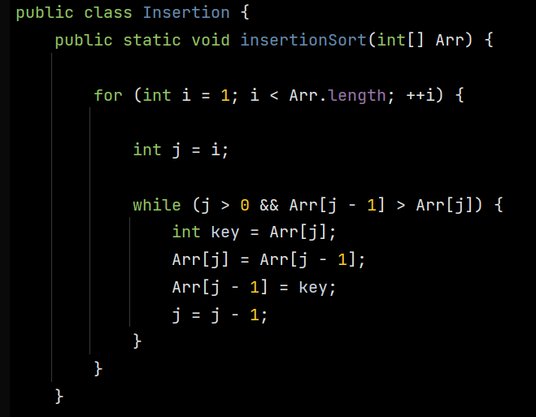
Insertion
SHORT EXPLANATION CODE

Slide 6
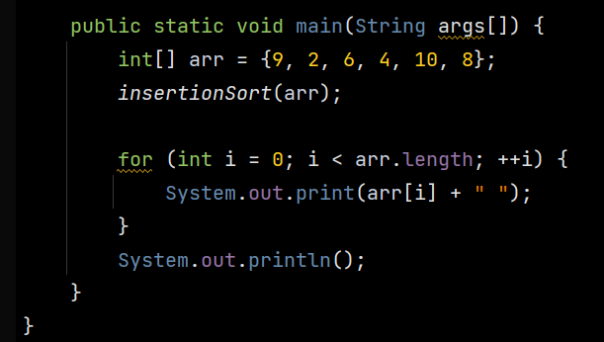

Insertion
SHORT EXPLANATION CODE

Slide 7
quick 3-way
SUBTITLE HERE

Slide 8
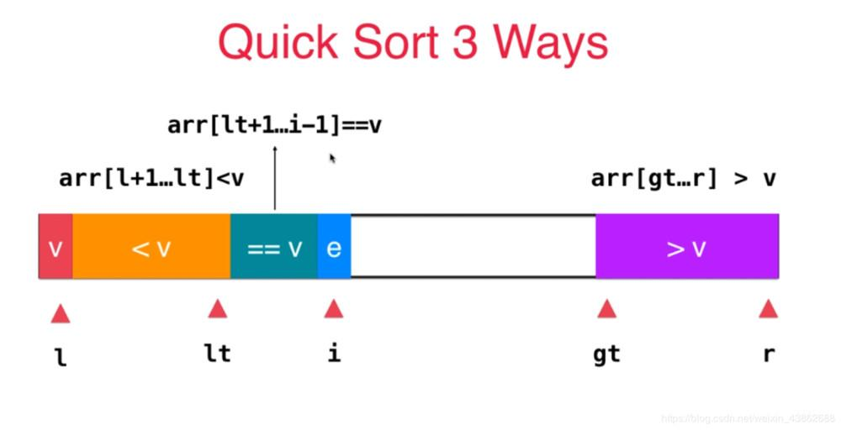
Quick 3Way Sort
01
Quick 3 way is similar to Quick sort but is more efficient and uses 3 partioming.
02
Quick 3way sort is a simple sorting algorithm which uses divide and partitioning technique .
soso
Highly Efficient.
03

Slide 9
Quick 3Way Sort
Best Case
𝛳N
Average Case
Θ N*(logN)
𝛳N^2.
Worst Case

Slide 10
MinPQ
SUBTITLE HERE

Slide 11
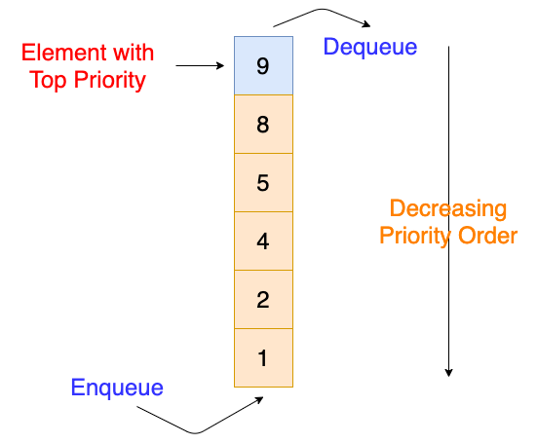
WHAT IS MinPQ?
A priority queue of generic keys
01
It supports the usual insert and delete-the-minimum operations. This implementation uses a binary heap.
02
A priority queue is a special type of queue in which each element is associated with a priority value.
By default, the priority queue in Java is min Priority queue with natural ordering.
03

Slide 12
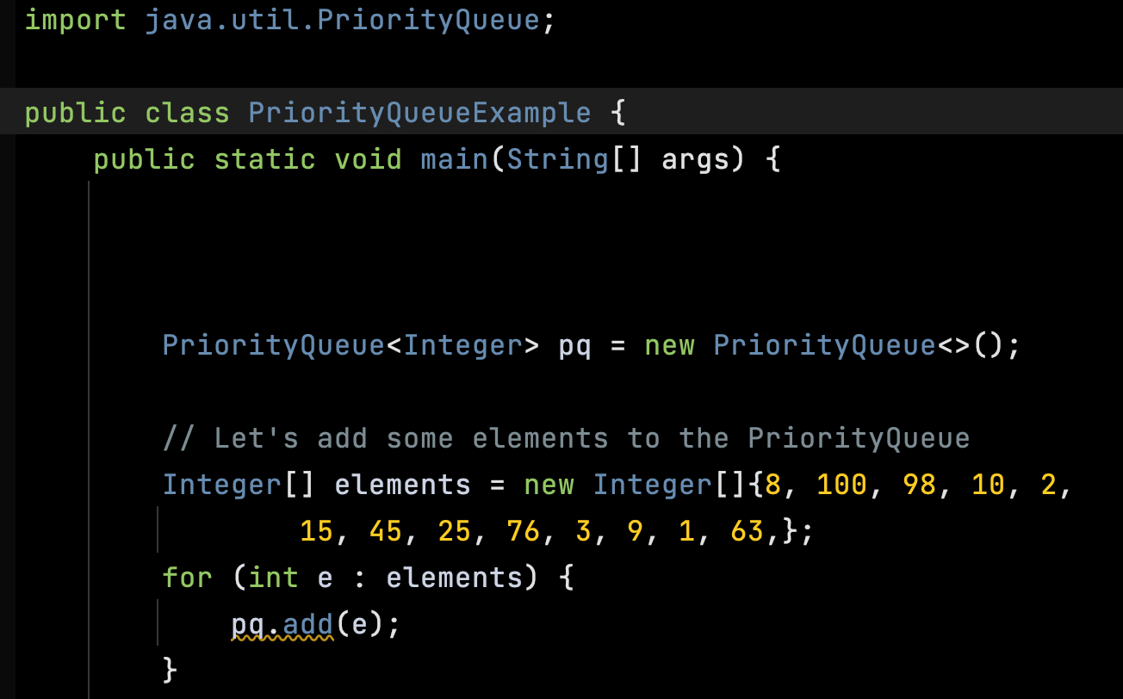
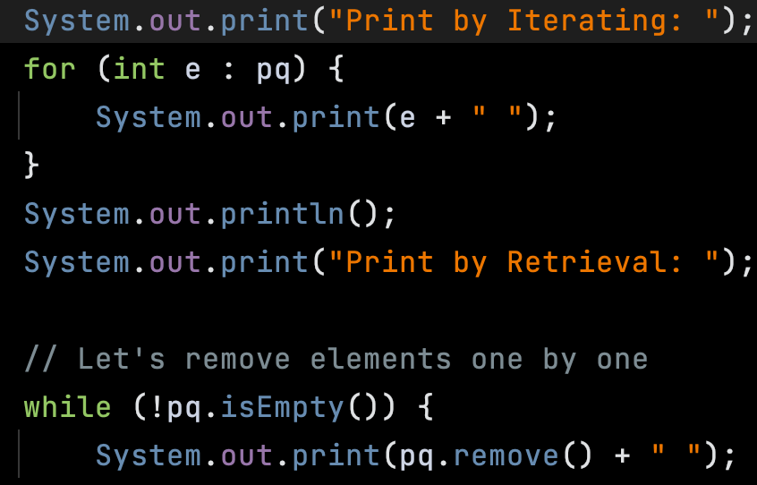
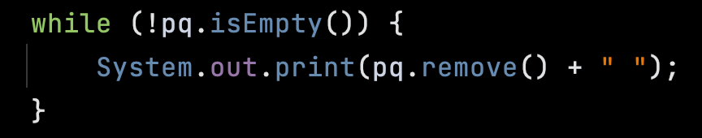
Priority Queue
EXAMPLE ANALYSIS
^{Create a priority Queue}
^{Iterate Trhough the Elements}
^{Remove Elements}

Slide 13
THANK YOU
2018

